Slide 1
OUTPUT
From new maps to enhanced decisions

Slide 2
Maps as Output
Users must be aware of the different forms of output such as maps, statistics and tables of numbers.
The term ‘output’ is used to describe the ways in which information can be presented.

Slide 3
Map as Output
It will influence the decision-making process.
The most common form of output is a map.
GIS output may be a 3D.

Slide 4
Maps as Output
The role is to communicate to user.
It is necessary to consider a design elements.
These include:
    the frame;
    the projection;
    the features;
    the generalization;
    annotation; and
    symbolism.

Slide 5
Maps as Output
It needs some form of spatial referencing.
A number of graphic and non-graphic devices are used.
The spacing and labelling of the grid lines provide information and the orientation

Slide 6
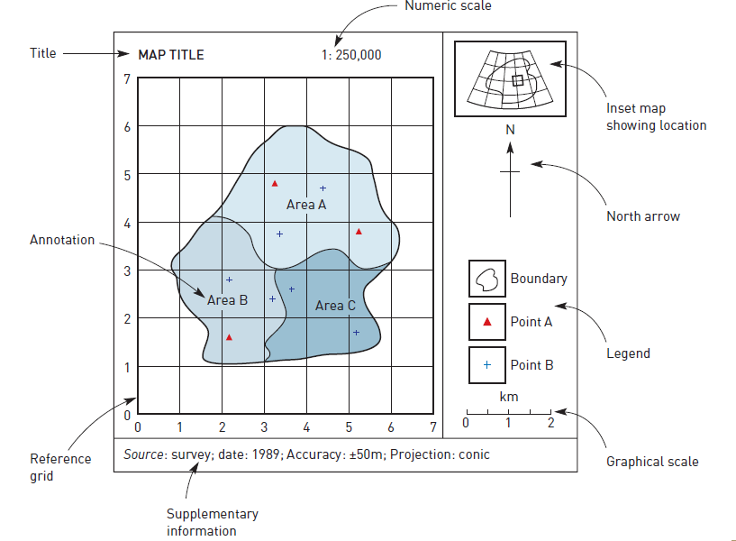
MAP COMPONENTS

Slide 7
Maps as Output
An inset map showing the location of the main map area.
For large-scale maps of small areas, planar co-ordinates derived from a local projection system.

Slide 8
Maps as Output
Maps are communication devices for spatial information.

Slide 9
MAPS AS OUTPUT
In creating quality cartographic output, it is necessary to consider both the level of detail and the relative positions.

Slide 10
MAPS AS OUTPUT
The high level of precision does not help.
For example, in a map showing the road network

Slide 11
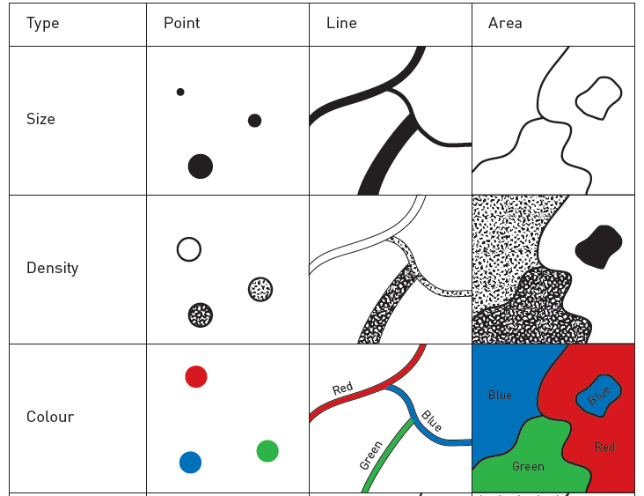
Cartographic symbolism

Slide 12
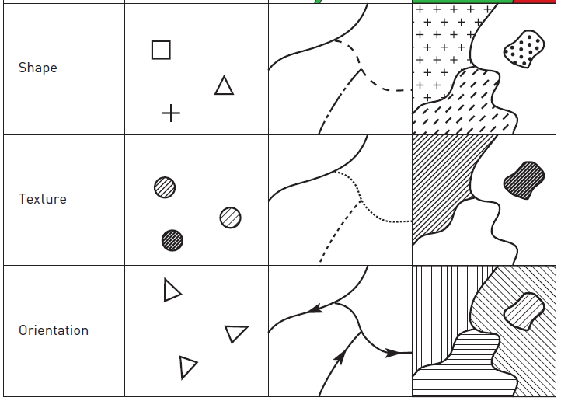
Cartographic symbolism

Slide 13
MAPS AS OUTPUT
It is necessary to generalize the detail of main roads
The roads and railway lines that follow close and parallel.
To avoid confusion between the two features we need to add a slight offset.

Slide 14
MAPS AS OUTPUT
Generalizing map information may be done.
Map symbolism can also be important.
Each symbol can differ in size, shape, density, texture, orientation and colour.

Slide 15
MAPS AS OUTPUT
The standard international colour scheme is green (easy), blue (intermediate), red (advanced), black (expert).
Colour is important in the understanding of the map.

Slide 16
MAPS AS OUTPUT
Black and white maps that use differently shaped symbols and shading patterns.
The shape and pattern used to bear some relation to the feature.
For example: use an anchor symbol to show the location of an airport and a lighthouse symbol to show the location of a public telephone.

Slide 17
MAPS AS OUTPUT
Our road and rail example:
Railway lines are plotted as (– – – – – – –)
Main roads as black lines with short perpendicular hatching (++++++).
Careful choice of shape and pattern of symbolism.

Slide 18
MAPS AS OUTPUT
Finally, density and texture of shading can affect the impression given by a map.
Monochrome choropleth map.
Thematic map.

Slide 19
MAPS AS OUTPUT
Annotation is textual and graphical information
The visual and numeric guides is a form of annotation.

Slide 20
MAPS AS OUTPUT
For example, information on a map showing the geography of the ‘Great Solar Eclipse’ of 14 July 1748. This is referred to as ‘metadata’.

Slide 21
MAPS AS OUTPUT
The primary objective of the map’s theme(s).
This involves technical decisions, generalization, positioning , colour and symbolism.

Slide 22
Alternative forms of cartographic output
Maps are drawn as plan views, 3D views and animation.

Slide 23
Alternative forms of cartographic output
A common use of cartograms is for drawing maps. This type of cartogram is known as a routed line cartogram.

Slide 24
Alternative forms of cartographic output
Routes are plotted as generalized lines.
Space distorted from a central point on the basis of time taken. These are known as central point linear cartograms.

Slide 25
Alternative forms of cartographic output
Another use of cartograms is to depict the size of non-spatial relative areas. These are referred to as area cartograms.
Popular method of visualization (3D).

Slide 26
Alternative forms of cartographic output
Animation can be useful for a strong temporal element.
‘played back’ as a series of frames, the change of pattern over time.
This technique has proved for identifying temporal patterns.

Slide 27
Alternative forms of cartographic output
Animation may be used in a similar way to display spatio-temporal processes.
By combining 3D mapping and animation, GIS packages can create realistic animation.
This is a powerful means of simulators.

